Slide 1








Our Team AMES For Space
Critical Design Review
June 4, 2016

Slide 2
Critical Design Review
Our Team Ames for Space - June 4, 2016
Presented by:
  Ian Malek Alex Safonov
  Logan Bayer Saipranav Venkatakrishnan
  Andrew Frank Daniel Yu
  Elliot Lee

Slide 3
Contents
Introduction
The Experiment
  Biology- What is the experiment
  Analytics- How will we determine results
Initial Block Diagrams
Subsystems
  Well Plate, Carousel, Skeleton
  Camera, Optics, & Lighting
  Servo Motor, Position Feedback
  Sensor Management, I2C network
  Data Storage. USB
  Software Environment
Current Block Diagrams
Communications
Wrap-up

Slide 4
Introduction
We seek to determine the effect that microgravity, as demonstrated in the International Space Station (ISS), has on the rate of mutation of bacteria. The rate of mutation will be found by examining the color change of the Escherichia coli (E. coli) colonies. This color change will be measured through photographs taken during the test, which the analytics team will then examine.
We hypothesize that microgravity and the ISS environment will affect the mutation rate. To test this hypothesis, we will compare results from experiment at the ISS with one on Earth simulating some of the environmental conditions.

Slide 5
Biology
Initial Question: Does evolution happen in space,
the same way it does on earth?
Our question came from a publication that documented an increase in pathogenicity for Salmonella typhimurium after growth in microgravity (Wilson et al., PNAS vol. 104 no. 41 16299–16304).
For our question we decided that the mechanics of the process of evolution; a mutation event that confers an advantage to the organism must be the same in space and on earth since all life as we know it has DNA and is the basis of evolutionary change.
We decided to test whether the rate of evolution was different in space than it is on earth.

Slide 6
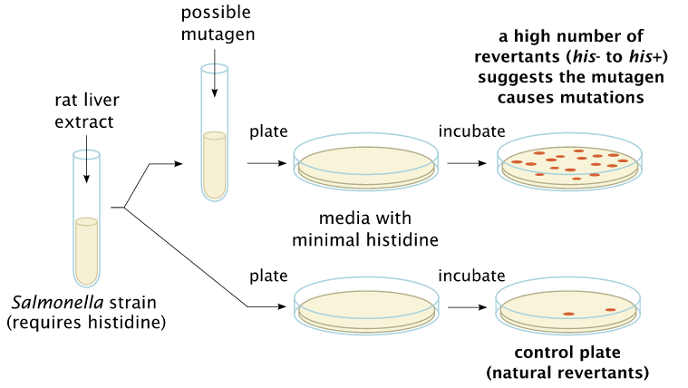
Experimental Approach: Ames Test-conventional (original design).
We decided on 2 changes to this conventional strategy
We decided to switch the micro-organism to Escherichia coli E. coli trp-, a less pathogenic strain requiring tryptophan to grow.
The experimental design was changed to accommodate a micro-well plate format.
Notes:
“Mutagen” is mixed into bacteria strain.
Bacteria/mutagen is spread on agar plates with small amount of histidine.
Bacteria allowed to grow with initial histidine.
Bacteria will die off if they do not mutate to produce their own histidine.
Mutated bacteria will regain histidine production and survive.
Count the colonies and compare to control.
Ratio of mutation compared to control indicates “mutation potential” of the mutagen.

Slide 7
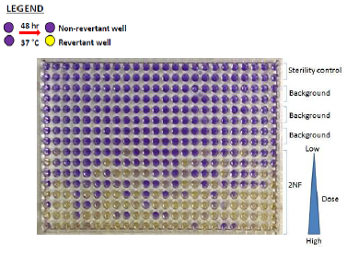
Experimental Approach: Ames Test-
Micro-Well approach
This pictogram shows that as the mutagen is diluted (higher rows) less of an effect is observed and the wells stay purple (trp-; mutations not detected).
In this pictogram high concentrations of mutagen (lower rows) have converted the purple wells to yellow (trp+; mutations detected), due to a shift in pH from growing bacteria.
Our Experiment proposes to look for differences in the rate of this change in microgravity on the International Space Station compared to the same experiment performed on the ground.

Slide 8
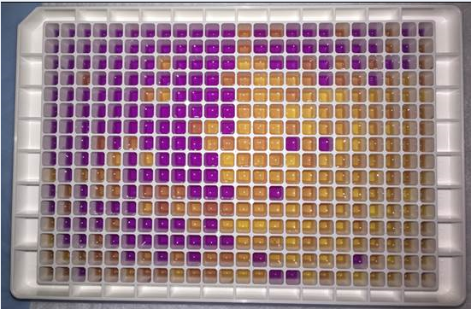
Preliminary Data: Proof of Concept
NEG Control
1:8 Dilution
1:64 Dilution
1:4 Dilution
1:32 Dilution
1:2 Dilution
1:16 Dilution
POS Control
Dilution of the mutagen (4-NQO) results in less revertants as the treatments become more dilute.
Multiple concentrations/dilutions allows us to evaluate the experiment across a range of treatments, thereby providing a scale of sensitivity.
The number of wells in each concentration provides some assurance that any differences detected can be evaluated for statistical significance when comparing the same dilutions on the space station versus the same experiment conducted on the ground.
Notes:
Major success

Slide 9
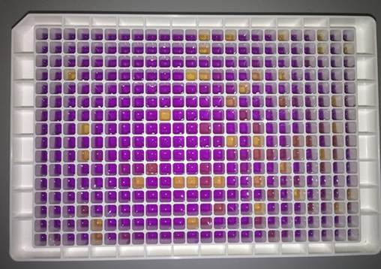
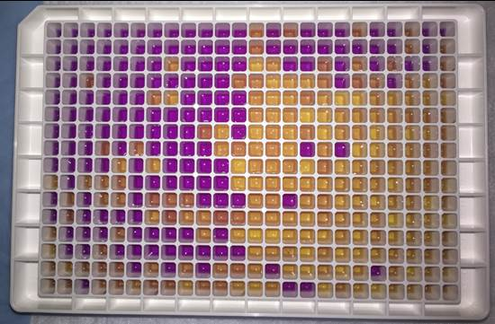
Biology Breakthrough: Room temperature incubation!
Original Plan | Room Temperature Test
Freeze dry E. coli mixtures in wells | Mix water and E. coli solution
Add water to wells | Freeze mixture in well plates
Ship to ISS | Ship to ISS
Test begins | Room temperature in ISS thaws mixture, test begins
Requires water piping, water pump OR seal between water and mixture in well | No pump, micro piping, reservoir, seals to break on ISS, mixing, and heaters needed!
Well plate after 2 days
Well plate after 9 days
Proof of concept results:
Bacteria would mutate at room temperature
Bacteria & solution survived freezing
  Special Note: Our E. coli supplier, Environmental Bio-Degradable Products, Inc., ran freeze/thaw test and room temperature tests (at their expense) to verify plan is feasible, also!

Slide 10
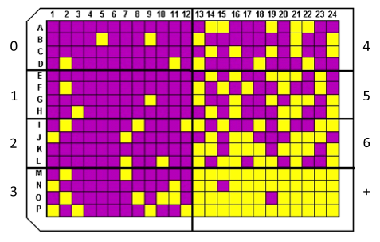
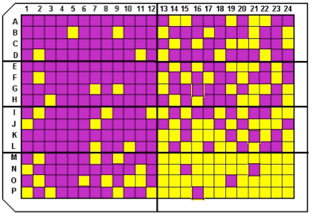
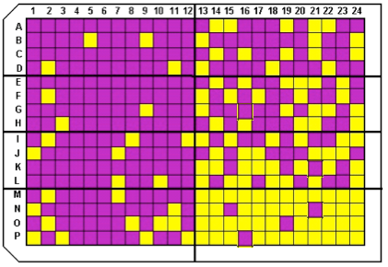
Data Analytics: Statistical Significance
As designed, the full experiment is:
  48 wells / concentration (or control)
  Background controls in triplicate: 48 x 3 = 144 wells
  Positive controls in triplicate: 48 x 3 = 144 wells
  6 concentrations in triplicate: 48 x 6 x 3 = 864 wells
Total Wells = 144+144+864 = 1152 wells
TOO BIG for our NanoRacks system.
NEED to reduce the experiment
Notes:
For validation, the experiment is usually run in triplicates. Each time, the results will most likely vary slightly. Questions: Is the variance significant? Or is each variation telling us basically the same thing??? These three plates are slightly different, but they are statistically the same!.

Slide 11
Statistical Significance Options
The NanoRacks & System design limits us to an 8 x 60 = 480 well system – further reduced to 384 wells after cutting into 8 sections
All options considered:
Column1 | Option 1 | Option 2 | Option 3 | Option 4 | Option 5 | Option 6 | Option 7 | Option 8
Wells / Concentration | 48 | 48 | 48 | 48 | 48 | 24 | 24 | 32
Controls | 2 | 2 | 2 | 2 | 2 | 2 | 2 | 2
Concentrations | 6 | 6 | 5 | 4 | 3 | 6 | 4 | 3
Replications | 3 | 2 | 3 | 3 | 2 | 3 | 3 | 3
TOTAL WELLS | 1152 | 768 | 1008 | 864 | 480 | 576 | 432 | 480
… PLUS MANY OTHERS
Triplicate preferred over duplicate
System size limitations restrict our options on sample size.
Notes:
Options: Fewer well / concentrations (48 decrease to 24 wells / concentrations); Fewer controls (no positive? No background?); Fewer concentrations (6 concentrations decrease to 4 concentrations?); Fewer replications (2 replications? Just one?)

Slide 12
Conclusion: Only 2 viable options
Option 8
  Would require all 480 cells
  Would provide higher statistical power
  Would allow only 3 concentrations
  Would allow triplicate
Option 7
  Would require only 432 cells
  Would provide lower statistical power
  Would allow 4 concentrations
  Would allow triplicate

Slide 13
Independent Variables to be Measured
To simulate the experiment on the ground and to understand potential variables in the experiment, the following items will be measured or captured.
Measured on Station
  Temperature
  Humidity
  Pressure
  Radiation
  Cell color change (Photographic)
  Date/Time Stamp (w/each photo)
Controlled variables
  Mutant Concentration
Other
  Cylinder position (1-8)
  System power status
  System error codes
  Date/Time
Notes:
Now that we know the experiment, and data points needed to be able to compare results of similar experiments at the ISS and on Earth, Ian will share the overall flowchart and

Slide 14
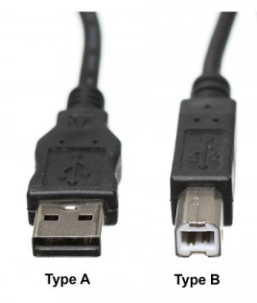
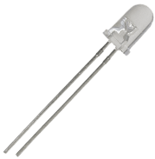
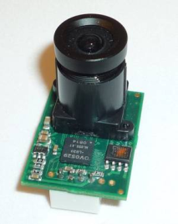
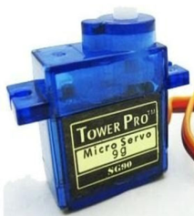
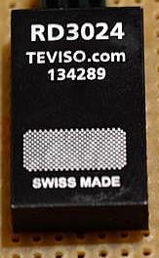
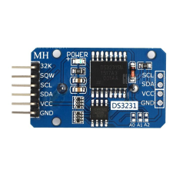
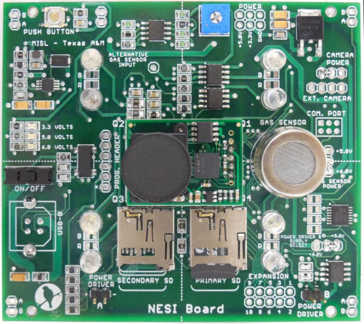
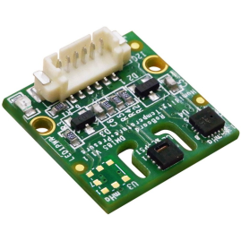
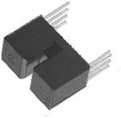
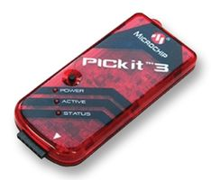

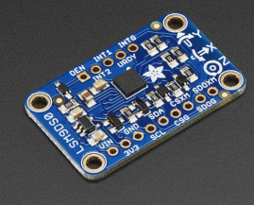
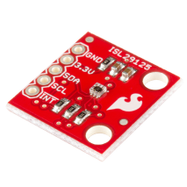
Camera 2 LEDs (x2)
Servo Motor
Camera 2
PWM
DO
Serial
Power
UART
Radiation Sensor
DFI
Real Time Clock
I2C
Temperature/Pressure/Humidity sensor
DI (x2)
I2C
Position Switch (x2)
DO
UART
I2C
Serial
Serial
accelerometer/magnetometer/gyroscope
Camera 1 LEDs (x2)
I2C
Camera 1
Microchip PicKit
Micro SD Card
(storage)
RGB Light Sensor (x2)

Slide 15
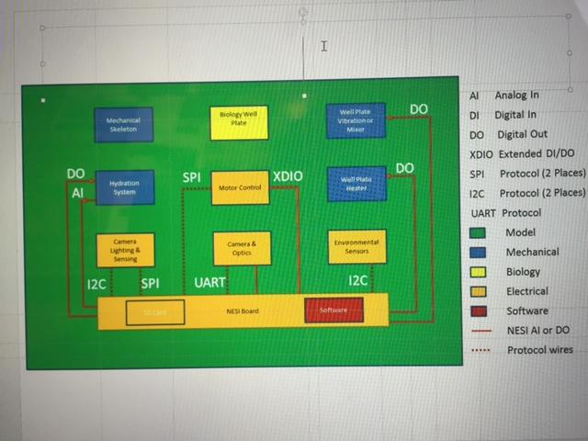
Functional Diagram
Design Blocks
Mechanical Skeleton
Biology Well Plate
Well Plate Vibration/Mixer
Hydration System
Motor Control
Well Plate Heater
Camera Lighting & Sensing
Camera & Optics
Environmental Sensors
NESI Board
SD Card
Embedded Software

Slide 16
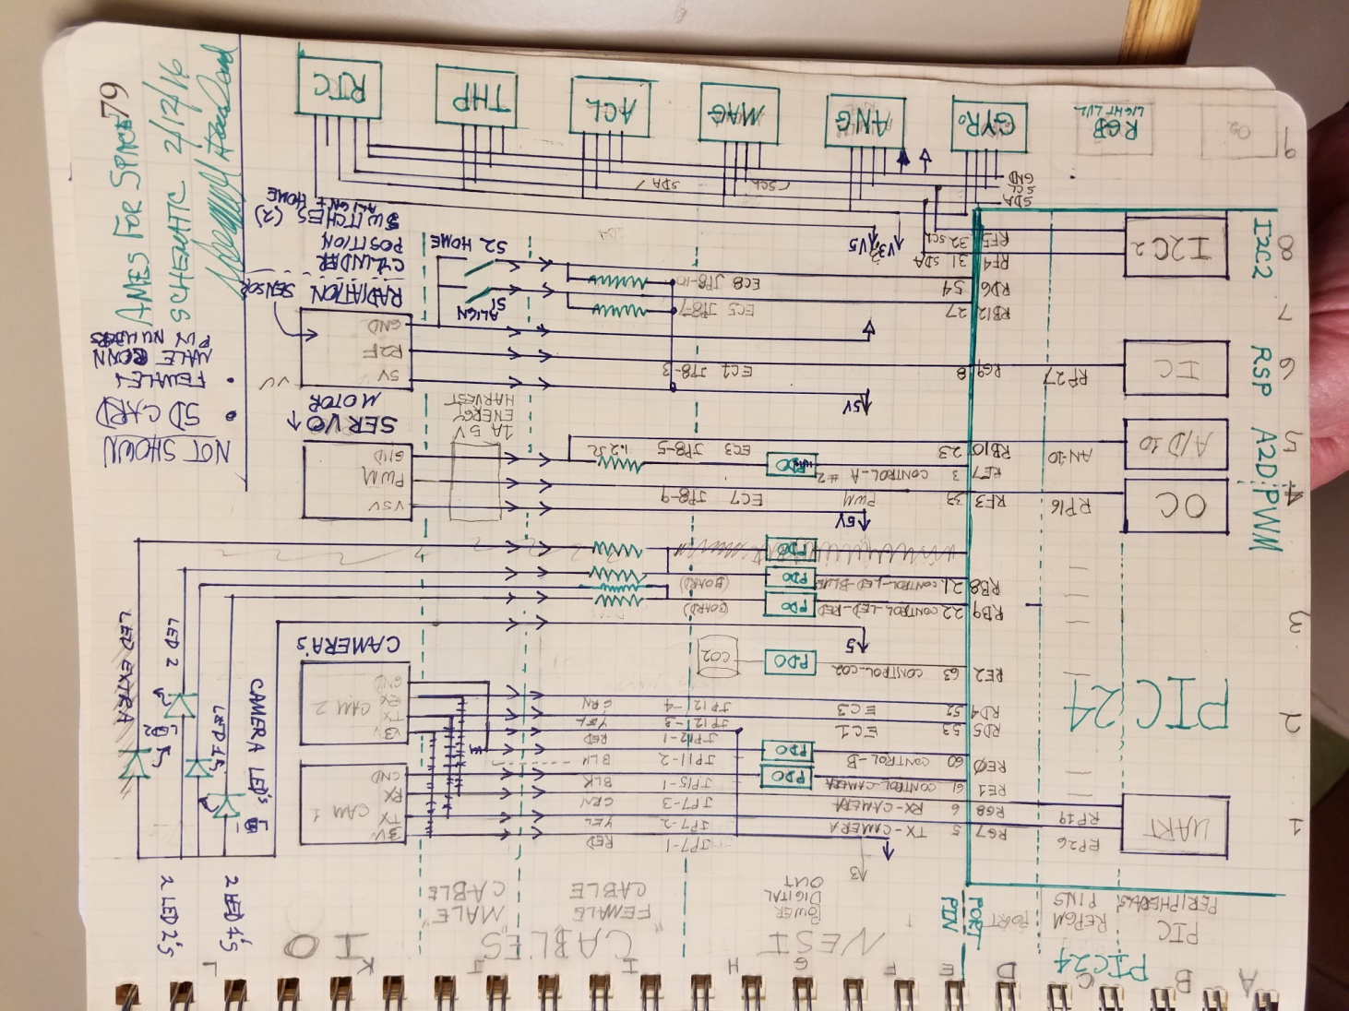
Conceptual Block Diagram
Design Blocks
A1 Real Time Clock
B1 Altitude Air Pressure
C1 Temperature, Humidity
D1 Gyroscope
E1 Light RGB & Composite
F1 Stepper Motor Driver
G1 Stepper Motor
E2 SPI Network
A3 ‘Align’ Position Switch
C3 PIC24 Processor
E3 Vibrator Motor
F3 Solenoid
A4 Position Sensing Resistor
E4 RGB LED common cathode
A5 Radiation Sensor (R2F)
E5 RGB LED common Anode
A6 (miscellaneous I/O adds)
C6 Dual H Drive DC motors
G2 Part Number Listings
(of available parts)

Slide 17
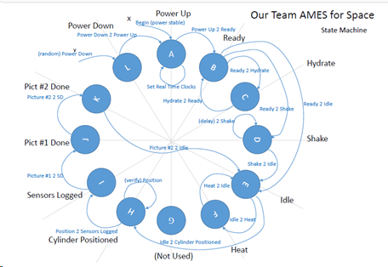
Conceptual SW State Machine

Slide 18
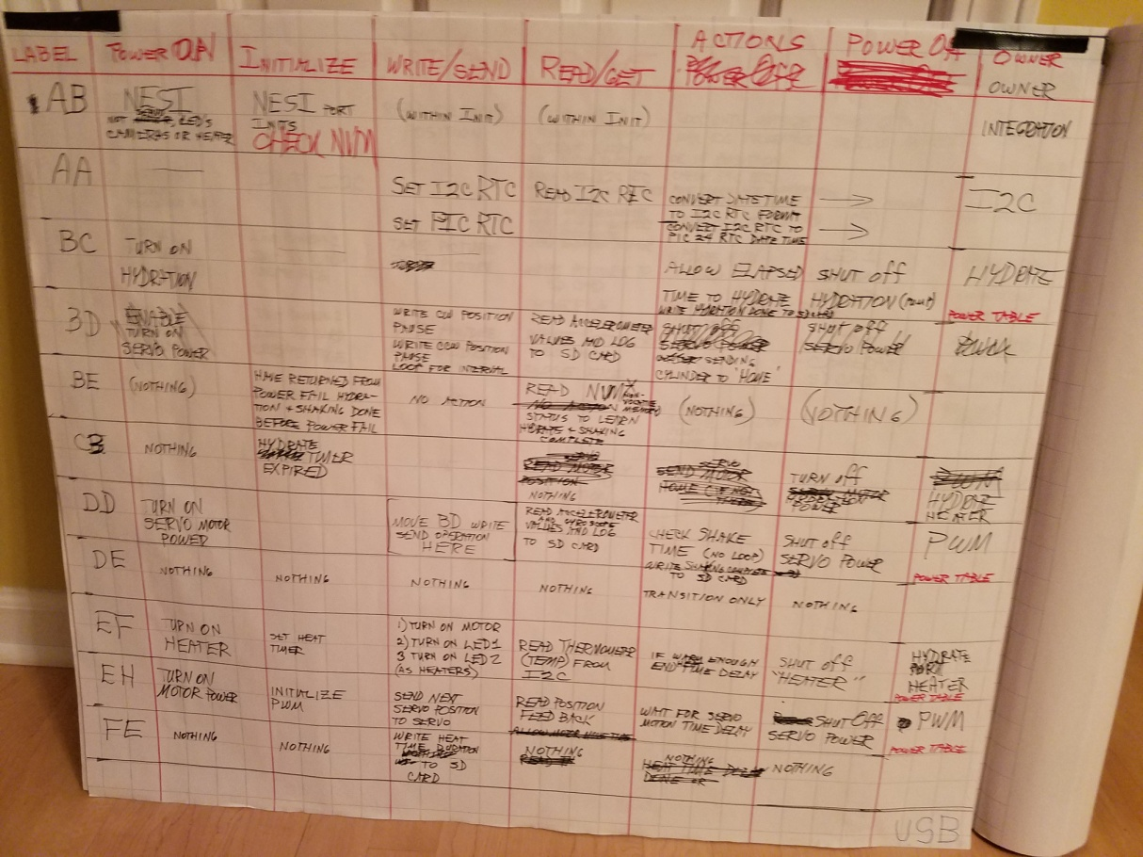
State Machine paths

Slide 19
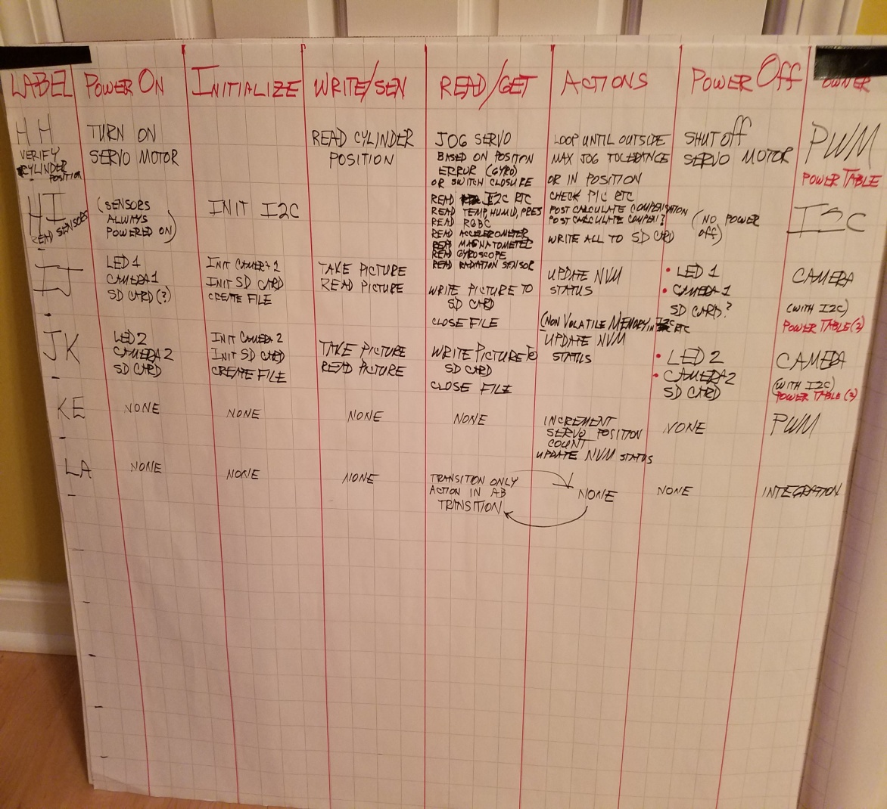
State diagram (cont’d)

Slide 20
Subsystems Evolution
Well Plate carousel
Rotating carousel – motor, positioning
Taking pictures - Camera, Optics, Lighting
Sensor Management
Data Storage, USB
Software Environment

Slide 21
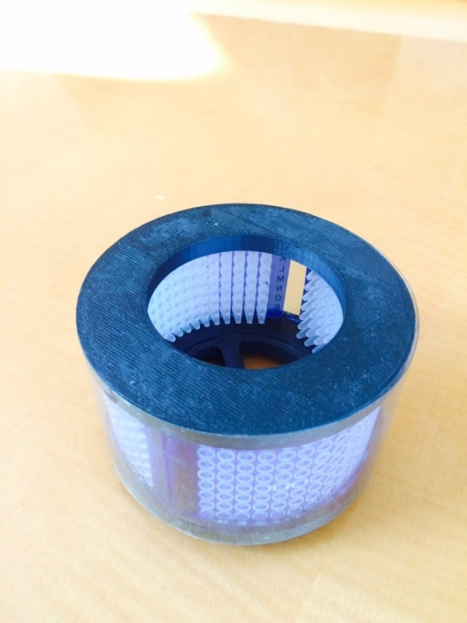
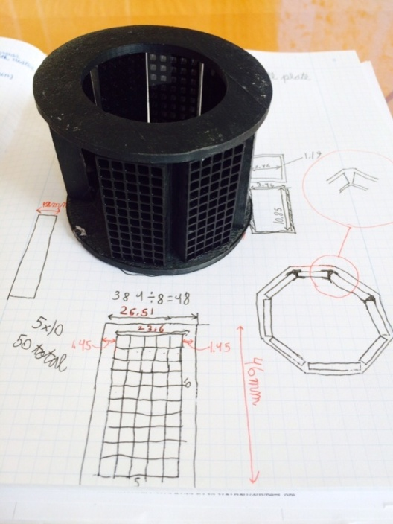
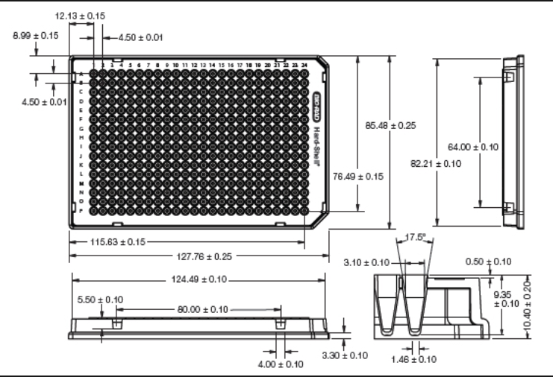
Well Plate – Skeleton Evolution
General:
  Need to devise a system that will: hold the bacteria media; ensure the experiment does not start until it reaches the ISS; set-up camera, lighting, and sensors to get in-focus pictures and readings
Issues:
  Freezing experiment may degrade plastics
  Mountings for motor, position sensor(s), and cameras
  Sensor assembly mounting
  Must sterilize well plates after cut to size- warped first material

Slide 22
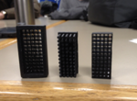
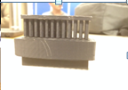
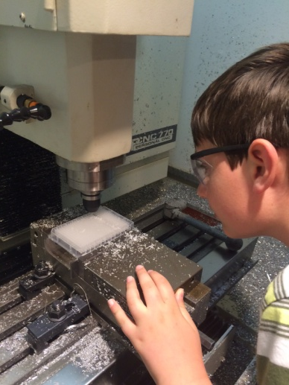
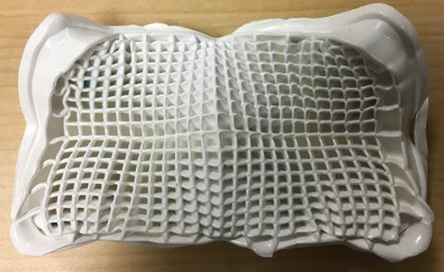
Well Plate Evolution (cont’d)
Created mini ice cube maker and pusher on 3D printer during plan to freeze dry the solution.
Started with 384 wells, but couldn't focus the camera, so the plate was split into 8 well plates with 50 wells each instead.
The plate has to be sterile, and the original plate melted in the sterilizer.
Plates are cut, sterilized, and snap into place on the carousel.

Slide 23
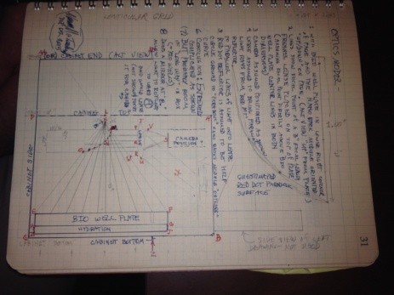
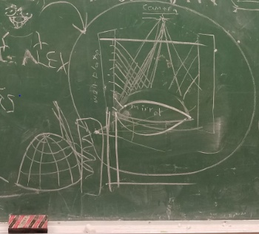
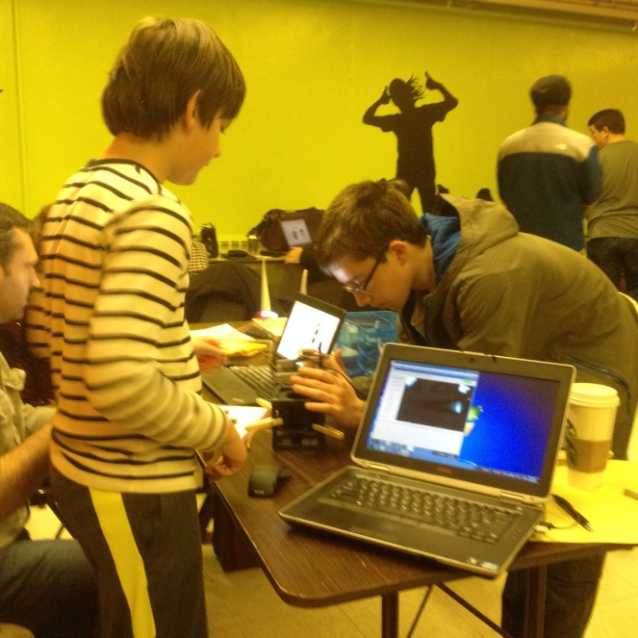
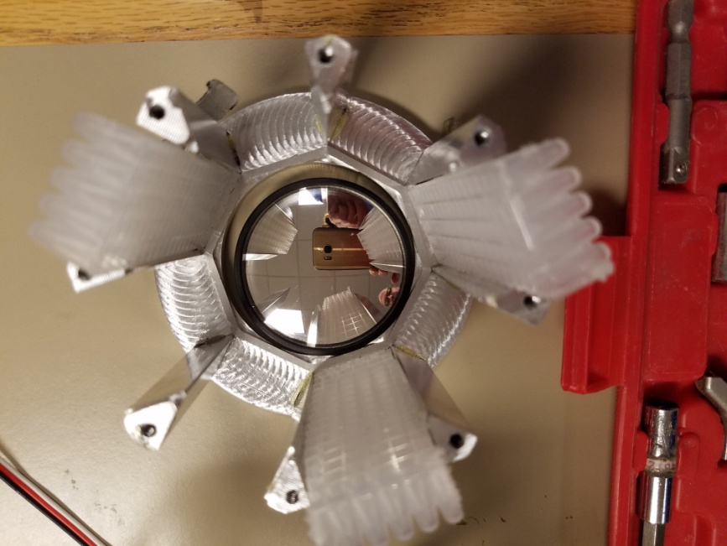
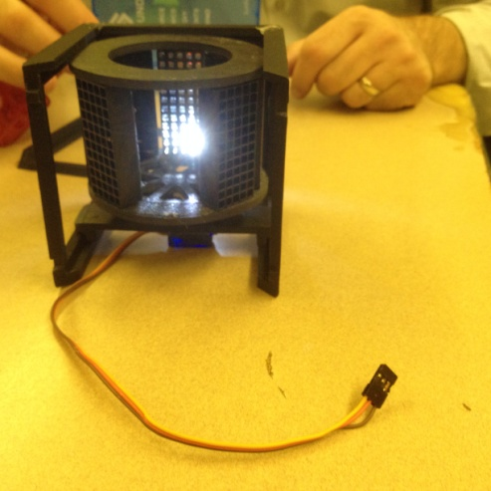
Camera Ideas & Testing
Mountain mirror?
Success, camera communicating w/laptop!
Convex mirror to see well plates

Slide 24
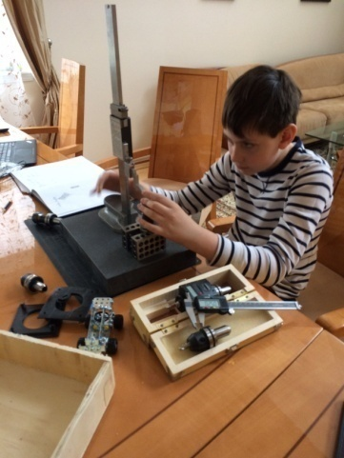
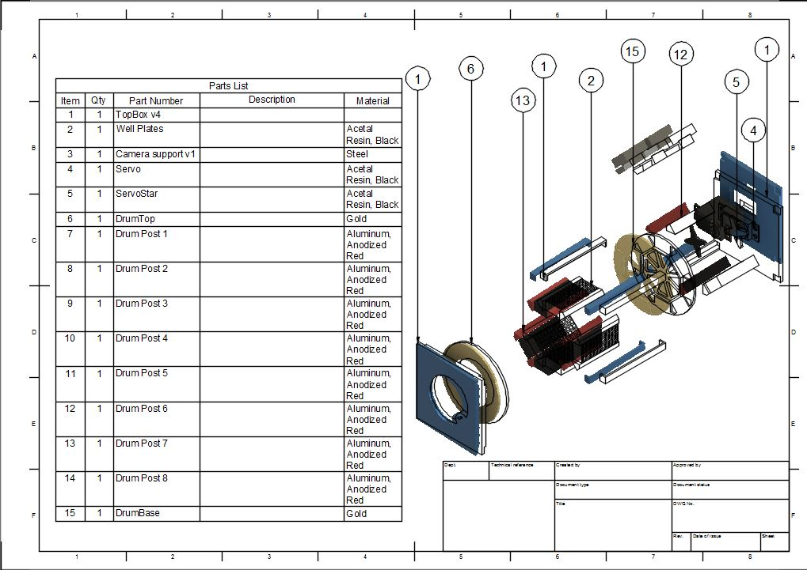
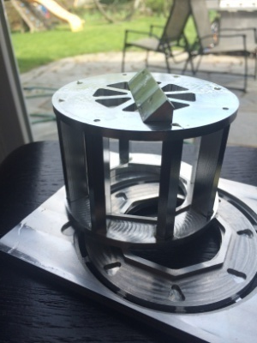
Carousel System
Designed and milled aluminum for carousel

Slide 25
Cameras, Optics, Lighting
General:
  Take detailed pictures of experiment (~ 1 revolution of 16 pictures per hour)
  Preselect proper lens, focus lens, lock in place
  Light pipes to illuminate well plate for pictures
Issues:
  Dual; camera option has flown before. Same cameras (C329)
  Could only make 1 camera work. Software update. Both fine now.
  Able to “expose” SD card to PC using TAMU USB interface. Able to see camera pictures on PC
  Camera Focus. Camera supplier prototype card didn’t work. Used USB solution to focus
  Light pipe design and location pending
Mechanical:
  Rigid camera mounting required to assure camera positioning
  Cable routing past moving carousel to stationary camera
  Light Pipe position resolution
Electronic:
  Must be careful of power usage. One camera one LED set at time, then move motor
Software:
  TAMU supplied updated Software- resolved camera issue. Thanks!

Slide 26
Well Plate vs. Camera Position
#1
#1
#1
#2
#1
#1
#2
#1
#1
#2
#2

Slide 27
Well Plate vs. Camera Position
AA
Make Well Plate round
Rotate plate to camera
Stationary camera inside
Camera secured opposite motor
Backlight Panel at camera
Motor opposite camera
Can’t load. Early wells drain
as rotate to load later wells
Servo
Motor
#1
#2
Servo
Motor
AA
AA
Make 8-60 well plates (48 usable)
Place wells in octagon
Snap into carousel with
10 top/bottom wells
Motor right, camera secured left
1 top, 1 bottom photo/position
2 wells reserved-position id
2 LED backlights (1 per camera)
#1
#2
Servo Motor
LED
s
Servo Motor
AA
Top view
Side view

Slide 28
Rotating Carousel: Motor, Position Sensing
General:
  Servo to align carousel well plates in front of cameras
  Position Sensing assures Carousel aligned with cameras
Issues:
  Servo size, power, rotation, gearing, analog/digital
  Position Sense: Opto, Gyro, internal (to motor) or external Pot
Mechanical:
  Mounting Pot or Gyro to Carousel
  Wire routing to moving carousel
Electronic:
  PWM Driver: digital resolution 4096 widths- analog is 256 widths)
  Position Sensing driver(s)
  Cabling and connectors
Software:
  Use Hardware delivered drivers

Slide 29
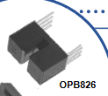
Rotating Carousel
Motor initialization code/process
Activate optical sensor
A tab on the carousel will trigger the Optek OPB 822 S dual channel encoder to indicate when the carousel is in the “home” position
Turn on motor to rotate carousel
Is carousel “home”
Yes
Take picture
Repeat 7 times
No
Rotate 315⁰ CCW
No
8th loop?
Rotate 45 degrees CW
Rotate
Yes

Slide 30
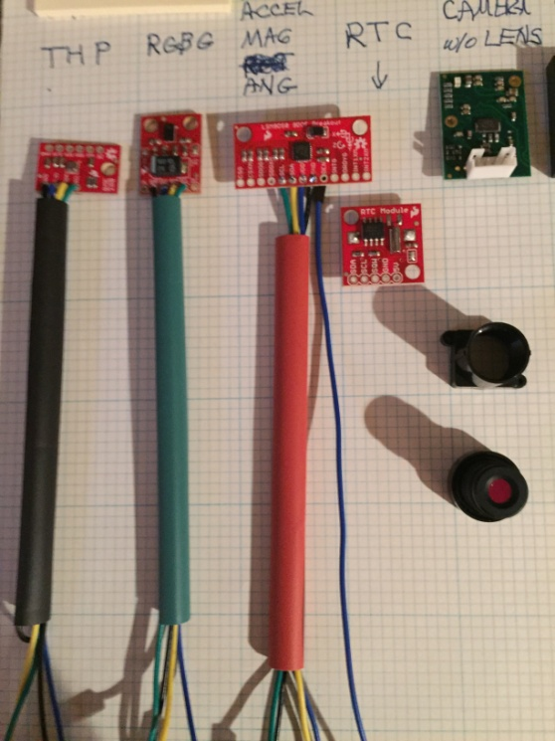
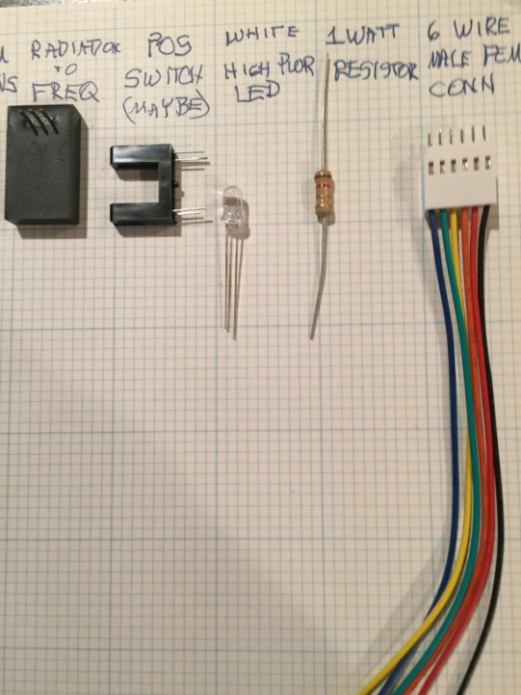
Sensors and Lighting
Multiple sensors are included in the design to get the most possible data. Some will and have been eliminated if not needed. Gas monitors have already been removed because there would not be enough change to monitor.
Temperature, humidity, pressure
Red, green, blue light
Accelerometer, magnetometer, gyroscope
Real-time clock
Radiation sensor
Position switch (Would replace Gyroscope)
LEDs

Slide 31
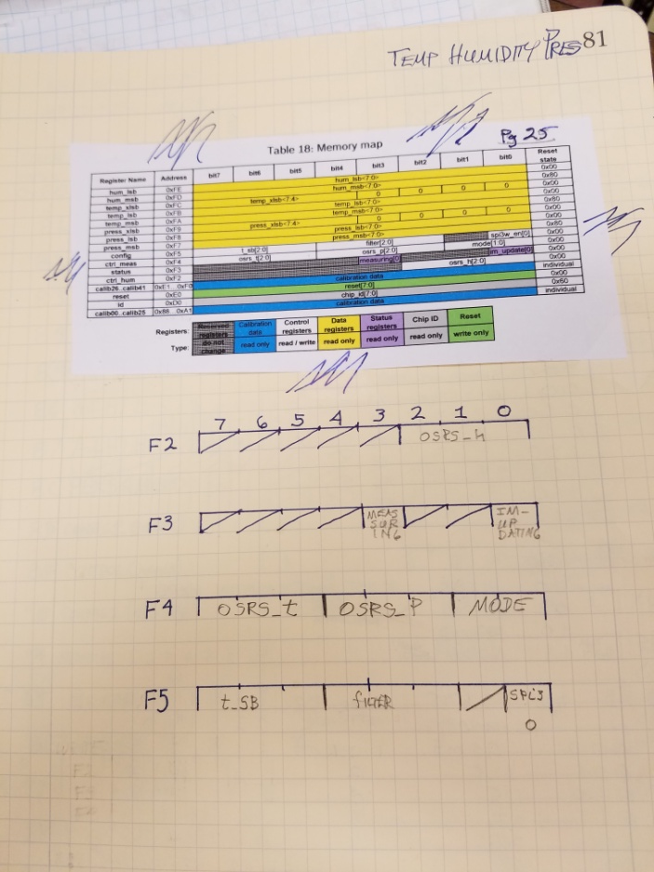
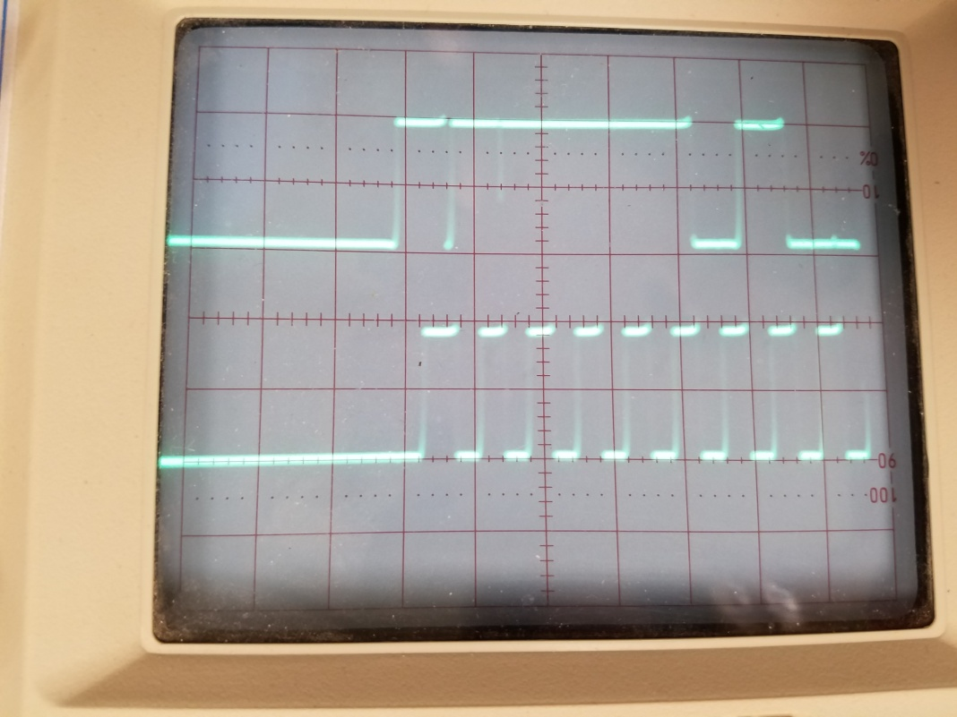
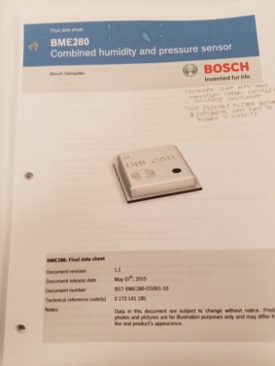
Trouble-shooting tools
Used information from sensor data sheets to write and test driver software.
Below shows ping and acknowledgement from Real Time clock.

Slide 32
SD Card, USB Interface
General:
  SD Card is primary storage for experiment
  USB Interface used to look at pictures from camera on SD card quickly
Issues:
  TAMU supplied software, worked!
  USB Interface helped with camera focus (supplier’s card failed)
Mechanical:
  Both on NESI board. No mechanical issues
Electronic:
  On NESI, no issues
Software:
  SD Card software builds a file system on SD Card
  Used existing TAMU code. Files are used by the camera, sensors, and also fault monitoring of I2C and hardware

Slide 33
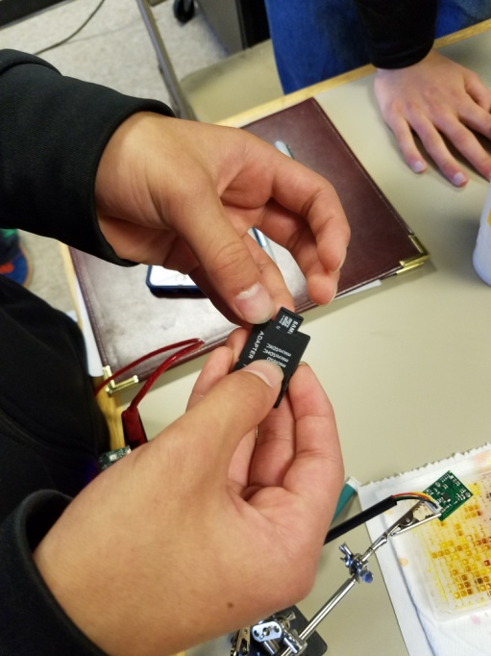
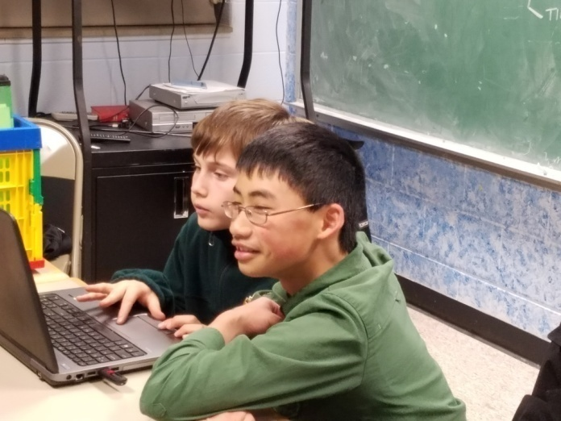
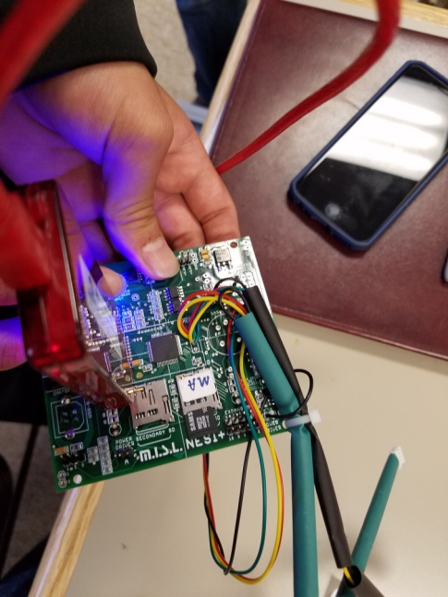
SD Card and USB
Took pictures and then transferred data to laptop to view the pictures.
USB Interface has since been enabled.

Slide 34








Communication Team Spreading the Word!
Demonstrations
How
Quest Academy Maker Day 5/20/16
Mission One – Chicago Museum of Science & Industry 5/19/16
Scout Sunday at First United Church of Palatine 2/7/16
Pancake Breakfast 2/13/16
St. Theresa’s Technology Fair 12/9/16

Slide 35
Wrap-up
We’ve gone through a lot of iterations, as we included any possible scenarios in our thought process. The youth have put in a lot of hard work to get us to what you see today.
Thank you for listening!

Slide 36
A Special Thanks To:
Mentors:
Norman McFarland
Don Bak
Jagmohan Bhasin
Kathy Cassady
Karl Frank
Don Harris
Mike Koehler
Dave Malek
Arnab Mallik
Andrea Onuskanich
Joe Pluta
Sergei Safonov
Jeffrey Short
Nikki Sullivan
Gil Willeumier
Brian Wood
Ken Yu
Team Members:
Kelvin Amy
Harmon Bhasin
Quinn Booker
Benjamin Carlsen
Simon Lui
Stephen Ma
Ayan Mallik
Madeline McFadden
Tony Pluta
Brad Posdal
Sarah Stapleton

Slide 37
Questions?

Slide 38
Back-up

Slide 39
Servo Motor
Carousel
Feedback Pot
Servo motor
or
NESI PWM
Output
NESI Input
Align Switch
or
Gyroscope
NESI PWM- duty cycle defines where SW wants carousel positioned
Motor reads PWM value, goes to position
One of Feedback options will confirm carousel aligned for picture
Servo Motor draws to much peak power
May need a power harvesting solution !

Slide 40
Servo Motor Block Diagram
Electronics
DC Motor
Gear Train
Feedback Potentiometer
Electronics measures PWM duty cycle
Compares ‘desired’ position to internal feedback pot
Decides direction and distance to move
Repeats above until destination reached
Motor current is average of ‘while moving’ (>400 mA) and ‘while stopped’ (0 mA)
Current increases when load (carousel) driven

Slide 41
Servo Motor Electronics
Feedback
Potentiometer
V_{Pos}
Compare
1
Run
H Bridge
Integrate
1
Error
Integrate
2
V_{FB}
V_{Err}
M
Compare
2
Dir
Volts
Reset
Volts
Reset
Volts
Volts
Reset
Volts
Reset
Time
Time
Time
Time
Run
Start Integrate 1 ramp on rising edge incoming pulse, stop Ramp on falling edge incoming pulse
Ramp voltage (V_{Pos}) directly proportional to incoming pulse width
Determine distance and direction by calculating: V_{Err}=K*(V_{FB} – V_{Pos})
Integrate 2 creates a reference voltage ramp
Compare 1 goes high at beginning of Integrate 2 ramp, goes low when voltage equals V_{Err}
If V_{Er}r > 0; Motor moves forward. If V_{Er}r < 0, motor goes reverse. V_{Er}r=0, motor stopped
Process repeats every 20 to 50 milliSeconds

Slide 42
Servo Power Droop

Slide 43
Ames for Space State and Flowchart Diagrams
Each Bubble is a “State.” Nothing happens within a state.
Each line is a transition. All operations happen during transitions.
States are labeled A-L. States also have names (outside circle in black).
Transitions are named as “from-state” to “to state.”
All flowchart work defines what happens in transitions.
X and Y are random power events – can’t plan them.
Start is at X going to A. From then on, operations move from state to state, but only by transition lines.

Slide 44
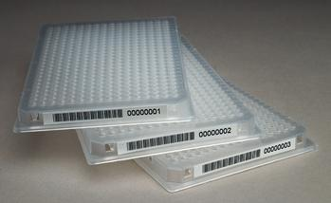


Fluctuation method
Original test was conducted on agar plates.
Fluctuation method uses same media but conducts the experiment in small “wells” in test plate. Each test plate contains 384 “wells”.
Usually divide 384 wells into 8 sections
48 wells positive control
48 wells negative (background) control
6 x 48 wells of different mutagen doses
384 well test plates
Each well runs the test.
Purple = not mutated
Yellow = mutated

Slide 45

Statistical Power
Can you differentiate between positive and negative results?
Samples size = 32 cells
6 out of the 24 possible results are too similar to statistically differentiate.

Slide 46
Statistical Power
Samples size = 32 cells
Binomial comparison for 2 ratios ( sample 1 and sample 2)
 |  | Sample 1 |  |  | Sample 2 |  |  |  |  |  |  |  |  |  |  | Statistically
 |  | Response | Sample size |  | Response | Sample size | p1 | p2 | p | q | p1-p2 | 1/N1+1/N2 | denom | z | p-value | significant at <0.05
Unequal variance |  | 32 | 32 |  | 1 | 32 | 1 | 0.031 | 0.516 | 0.484 | 0.969 | 0.063 | 0.031 | 31.496 | 0 | Yes
 |  | 31 | 32 |  | 2 | 32 | 0.969 | 0.063 | 0.516 | 0.484 | 0.906 | 0.063 | 0.053 | 17.197 | 0 | Yes
 |  | 30 | 32 |  | 3 | 32 | 0.938 | 0.094 | 0.516 | 0.484 | 0.844 | 0.063 | 0.067 | 12.597 | 0 | Yes
 |  | 29 | 32 |  | 4 | 32 | 0.906 | 0.125 | 0.516 | 0.484 | 0.781 | 0.063 | 0.078 | 10.025 | 0 | Yes
 |  | 28 | 32 |  | 5 | 32 | 0.875 | 0.156 | 0.516 | 0.484 | 0.719 | 0.063 | 0.087 | 8.279 | 0 | Yes
 |  | 27 | 32 |  | 6 | 32 | 0.844 | 0.188 | 0.516 | 0.484 | 0.656 | 0.063 | 0.094 | 6.964 | 0 | Yes
 |  | 26 | 32 |  | 7 | 32 | 0.813 | 0.219 | 0.516 | 0.484 | 0.594 | 0.063 | 0.101 | 5.908 | 0 | Yes
 |  | 25 | 32 |  | 8 | 32 | 0.781 | 0.25 | 0.516 | 0.484 | 0.531 | 0.063 | 0.106 | 5.02 | 0 | Yes
 |  | 24 | 32 |  | 9 | 32 | 0.75 | 0.281 | 0.516 | 0.484 | 0.469 | 0.063 | 0.11 | 4.248 | 0 | Yes
 |  | 23 | 32 |  | 10 | 32 | 0.719 | 0.313 | 0.516 | 0.484 | 0.406 | 0.063 | 0.114 | 3.559 | 0.0002 | Yes
 |  | 22 | 32 |  | 11 | 32 | 0.688 | 0.344 | 0.516 | 0.484 | 0.344 | 0.063 | 0.117 | 2.93 | 0.0017 | Yes
 |  | 21 | 32 |  | 12 | 32 | 0.656 | 0.375 | 0.516 | 0.484 | 0.281 | 0.063 | 0.12 | 2.346 | 0.0095 | Yes
 |  | 20 | 32 |  | 13 | 32 | 0.625 | 0.406 | 0.516 | 0.484 | 0.219 | 0.063 | 0.122 | 1.794 | 0.0364 | Yes
 |  | 19 | 32 |  | 14 | 32 | 0.594 | 0.438 | 0.516 | 0.484 | 0.156 | 0.063 | 0.123 | 1.266 | 0.1027 | No
 |  | 18 | 32 |  | 15 | 32 | 0.563 | 0.469 | 0.516 | 0.484 | 0.094 | 0.063 | 0.124 | 0.754 | 0.2255 | No
 |  | 17 | 32 |  | 16 | 32 | 0.531 | 0.5 | 0.516 | 0.484 | 0.031 | 0.063 | 0.125 | 0.25 | 0.4012 | No
 |  | 16 | 32 |  | 17 | 32 | 0.5 | 0.531 | 0.516 | 0.484 | -0.03 | 0.063 | 0.125 | 0.25 | 0.4012 | No
 |  | 15 | 32 |  | 18 | 32 | 0.469 | 0.563 | 0.516 | 0.484 | -0.09 | 0.063 | 0.124 | 0.754 | 0.2255 | No
 |  | 14 | 32 |  | 19 | 32 | 0.438 | 0.594 | 0.516 | 0.484 | -0.16 | 0.063 | 0.123 | 1.266 | 0.1027 | No
 |  | 13 | 32 |  | 20 | 32 | 0.406 | 0.625 | 0.516 | 0.484 | -0.22 | 0.063 | 0.122 | 1.794 | 0.0364 | Yes
 |  | 12 | 32 |  | 21 | 32 | 0.375 | 0.656 | 0.516 | 0.484 | -0.28 | 0.063 | 0.12 | 2.346 | 0.0095 | Yes
 |  | 11 | 32 |  | 22 | 32 | 0.344 | 0.688 | 0.516 | 0.484 | -0.34 | 0.063 | 0.117 | 2.93 | 0.0017 | Yes
 |  | 10 | 32 |  | 23 | 32 | 0.313 | 0.719 | 0.516 | 0.484 | -0.41 | 0.063 | 0.114 | 3.559 | 0.0002 | Yes
 |  | 9 | 32 |  | 24 | 32 | 0.281 | 0.75 | 0.516 | 0.484 | -0.47 | 0.063 | 0.11 | 4.248 | 0 | Yes
 |  | 8 | 32 |  | 25 | 32 | 0.25 | 0.781 | 0.516 | 0.484 | -0.53 | 0.063 | 0.106 | 5.02 | 0 | Yes
 |  | 7 | 32 |  | 26 | 32 | 0.219 | 0.813 | 0.516 | 0.484 | -0.59 | 0.063 | 0.101 | 5.908 | 0 | Yes
 |  | 6 | 32 |  | 27 | 32 | 0.188 | 0.844 | 0.516 | 0.484 | -0.66 | 0.063 | 0.094 | 6.964 | 0 | Yes
 |  | 5 | 32 |  | 28 | 32 | 0.156 | 0.875 | 0.516 | 0.484 | -0.72 | 0.063 | 0.087 | 8.279 | 0 | Yes
 |  | 4 | 32 |  | 29 | 32 | 0.125 | 0.906 | 0.516 | 0.484 | -0.78 | 0.063 | 0.078 | 10.025 | 0 | Yes
 |  | 3 | 32 |  | 30 | 32 | 0.094 | 0.938 | 0.516 | 0.484 | -0.84 | 0.063 | 0.067 | 12.597 | 0 | Yes
 |  | 2 | 32 |  | 31 | 32 | 0.063 | 0.969 | 0.516 | 0.484 | -0.91 | 0.063 | 0.053 | 17.197 | 0 | Yes
 |  | 1 | 32 |  | 32 | 32 | 0.031 | 1 | 0.516 | 0.484 | -0.97 | 0.063 | 0.031 | 31.496 | 0 | Yes
Better Statistical Power
6 out of the 32 possible results are too similar to statistically differentiate .

Slide 47
Thought Process
You need to have replicates
  At least 2
  Prefer to have 3
You need to have numerous controls
  3 positive + 3 background (negative)
How many concentrations
  6? 5? 4? 3?
Reduce number of wells/concentrations?
  24 or 32 rather than 48?
  Is this still statistically significant?

Slide 48
Statistical Significance
Binomial Statistics
  For data with two possible results:
    Yes/ No … Positive / Negative … Boy / Girl … On / Off
Concentration effects (Option 7)
  Non-linear effect requires more concentrations
Triplicate preferred over duplicate (Options 7 & 8)
Statistical power increases with # of wells scored (Options 5 & 8)
Column1 | Option 1 | Option 2 | Option 3 | Option 4 | Option 5 | Option 6 | Option 7 | Option 8
Wells / Concentration | 48 | 48 | 48 | 48 | 48 | 24 | 24 | 32
Controls | 2 | 2 | 2 | 2 | 2 | 2 | 2 | 2
Concentrations | 6 | 6 | 5 | 4 | 3 | 6 | 4 | 3
Replications | 3 | 2 | 3 | 3 | 2 | 3 | 3 | 3
TOTAL WELLS | 1152 | 768 | 1008 | 864 | 480 | 576 | 432 | 480
Notes:
In our experiment, the result in each well will be either purple (original color) or yellow (new color if mutate).

Slide 49


Hydration, Vibration, Heaters
Plan
  Freeze dry the e Coli mixtures in wells
  Ship to ISS
  Add Water to wells
  Test begins
Reality
  Water Reservoir, Micro Piping, Water Pump OR
  Mixture in half of well, water other half, seal between.
3 nights of brainstorming
  10-15 people per week
  One team says- what if we freeze the water and mixture
Solution
  Mix water and e Coli solution
  Freeze mixture in well plates
  Ship to ISS
  Ambient temperature in ISS thaws mixtures
  Test begins
Results
  No Pump, no micro piping, no reservoir
  No seals to break on ISS
  No vibration and no heaters needed*
Special note:
  Our e Coli supplier, Environmental Bio-Degradable Products, Inc., ran freeze/thaw test and room temperature tests (at their expense) to verify plan is feasible. We also tested freeze/thaw.

Slide 50

Well Plate, Cylinder, Skeleton

