Slide 1
The Center for the Advancement of Science in Space
Manager of the International Space Station U.S. National Laboratory
Space Station National Design Challenge

Slide 2
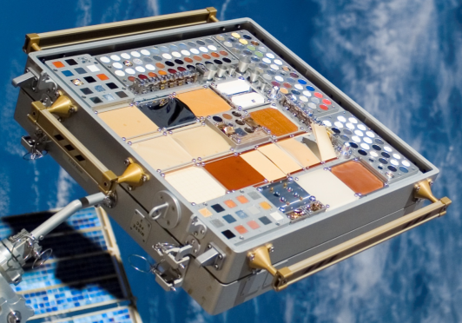
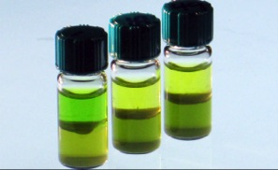
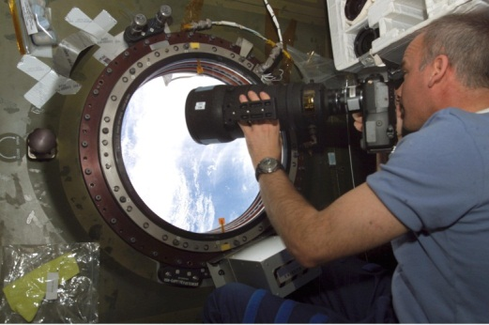
International Space Station
Took 10 years and over 30 missions to assemble; the result of collaboration among 5 space agencies representing 15 countries
CASIS is the manager of the International Space Station’s U.S. National Laboratory
Algae-derived biofuels
Materials Science: Passive exposure to space
Solar cell from
monocrystalline silicon wafer
Photographing Earth from the ISS
Images courtesy of NASA
Notes:
2005 - Congress designates the U.S. portion of the International Space Station as a National Laboratory
2011 – NASA selected CASIS to manage the national lab

Slide 3
CASIS National Design challenge Partners
NanoRacks provides the technical payload integration services as well as the on-orbit hardware and logistical requirements
Spark Fun Electronics provides sensors as well as hardware components to support experimental designs
Texas A&M provides the flight hardware as well as technical support and training for student teams

Slide 4
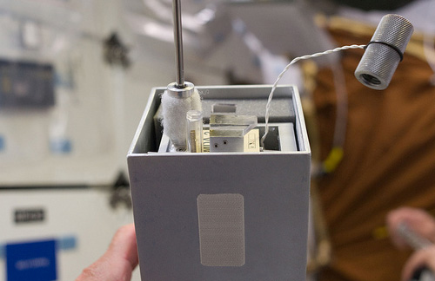
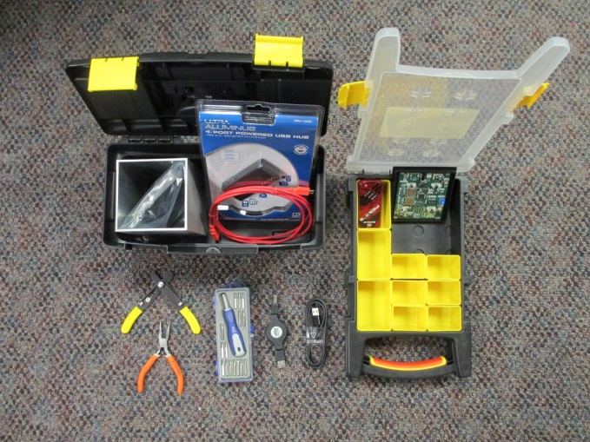
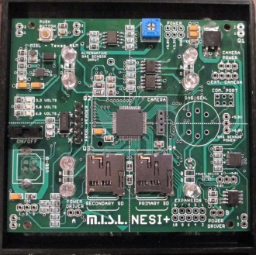
The space hardware: NanoLab
I.5 U cubesat form container
NESI Board, temperature sensor, soleniod, LEDs, Quick Start Guide
Programmable micro-controller, allowing automation, control, and data collection
3 NanoLabs will be sent to the ISS from the Chicago area
Notes:
Automated experiments lessen the amount of crew time; Data can be collected weekly from ISS.
Easy to integrate and control hundreds of different analog & digital sensors, stepper motors, cameras, lights, etc. to control and collect data from the experiment on the ISS.

Slide 5
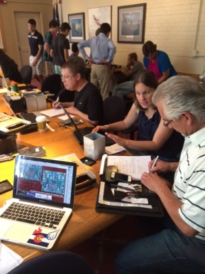
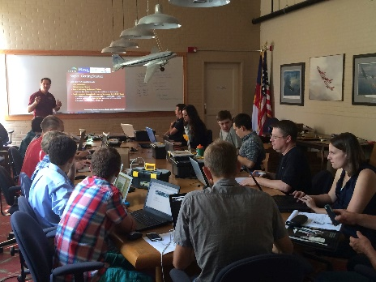
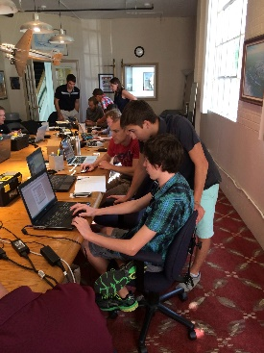
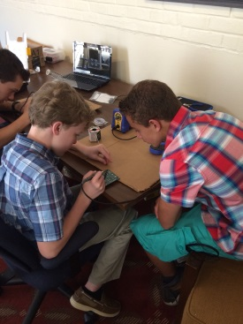
The Key: technical Development workshops
CASIS staff provide technical training and mentoring for the teams on topics such as microgravity research, experimental design, engineering design and the flight integration process
Texas A&M staff and student mentors provide training for team leads on development of hardware and software and technical support
Spark Fun Electronics provides sensors as well as hardware components to support experimental designs

Slide 6
The key: team Mentors
Possess general programming experience with basis programming language for microcontrollers
Serve as a subject matter expert for one or more team of students from your local area
Assist the team lead and students with experiment and engineering design, computer programming, fabrication of hardware
Assist with the iterative design process of the ground and space-based experiment - help to break down large unwieldy problems into smaller parts
Attend events and technical workshops

Slide 7
Examples of Awarded research
The Effects of Different Wavelengths of Light on Algae Oxygen Production in Microgravity
Carbon Dioxide Emissions of Yeast Cells in a Microgravity Environment
Use of Boron-Enhanced High-Density Polyethylene for Radiation Shielding
The Effects of Microgravity and Light Wavelength on Plant Growth in Microgravity
The Behavior of Slime Molds (Physarum) in Microgravity
Self-assembly of Mesoscopic Lipid Mimics

Slide 8
NDC website: http://ndcpilotdenver.weebly.com

Slide 9
MEDIA Coverage
Houston school was featured in a Wired Magazine article on 10/2/13 titled: Thirteen-Year-Olds Hack Their Way Into Space
http://www.wired.com/2013/10/arduinolab/
Fox News TV News coverage of Denver experiment
http://kdvr.com/2014/05/13/boulder-students-will-have- project-sent-to-international-space-station
Jefferson County Public Schools-TV Flight of the Wormonauts
https://www.youtube.com/watch?v=j3VQgjm1-pU

Slide 10
National Design challenge Timeline
Spring 2015
Summer/Fall 2015
Fall 2015/Spring 2016
Summer 2016
Application
and selection process
Technical workshops to learn about microgravity, experiment and engineering design, and flight hardware
Experiment research and concept design; Ground testing of prototype; Payload testing; Integration activities with NanoRacks
Send experiments to the ISS National Lab
Summer/Fall 2016
Experiments returned to Team Leads; Analyze data; Present outcomes at STEM Conferences

Slide 11
National Design challenge Application Process
BSA and CASIS will publish and promote the Challenge via established channels
Interested adult facilitators and mentors will be invited to a live webinar to learn about the program prior to submitting an application
Facilitators will submit their applications to CASIS (online process)
Applications will be reviewed and scored by BSA/CASIS panelists with defined criteria
CASIS will select and award 3 flight-based projects

Slide 12
National Design challenge Grant Breakdown – flight teams
CASIS award provides each team with the following items:
1 flight-based and 1 ground-based NanoLab and accessories
Technical support provided by Texas A&M
ISS integration, safety support, and on-orbit hosting by NanoRacks
Discretionary funds (grant) in the amount of $6K
Grant funds must be used on the NDC project:
Additional hardware components (clocks, sensors, etc.) for ground and flight-based NanoLabs
Experimental and fabrication costs
Travel expenses and other incidentals

Slide 13
Boy Scout Merit Badges
18 merit badges could be earned through the NDC Program:
Art
Chemistry
Communication
Composite materials
Computers
Digital Technology
Drafting
Electronics
Engineering
Graphic Arts
Inventing
Model Design and Building
Moviemaking
Photography
Programming
Plant Science
Robotics
Space Exploration
Notes:
Some merit badges are dependent upon the topic of the experiment.

Slide 14
Boy Scouts of America involvement
Assist with outreach and promotion of the NDC Pilot Program in Chicago and the surrounding area
Support implementation of the NDC Challenge competition in Chicago
Assist CASIS in the evaluation process to select the “flight” teams for the Space Station National Design Program
Provide facilities to host events and technical workshops
Help CASIS to identify technical expertise and mentors in the Chicago area to assist the student teams
Identify partnerships in the local Chicago area that would support the program with in-kind or financial resources

Slide 15
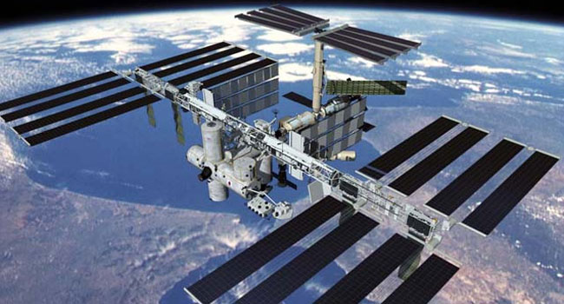
THE CASIS-BSA NATIONAL DESIGN CHALLENGE IS AN OPPORTUNITY FOR THE BSA TO TAKE THEIR STUDENTS AND COMMUNITY ON A ONE OF A KIND JOURNEY……
230 MILES IN SPACE TO THE INTERNATIONAL SPACE STATION
U.S. NATIONAL LABORATORY

Slide 16
QUESTIONS?
wwww.iss-casis.org
Twitter: @iss_casis

