Slide 1
Frame 1/2a Overview
James Miller
Payload Integration Lead

Slide 2
Company Summary
Space 4 Everyone
Started in 2006
Provides development, integration and operation for commercial, education and government
Agreement with NASA to utilize ISS as a National Lab
Average is 9 months to get new payloads into space

Slide 3
Types of payloads
Internal
Mixsticks
NanoLabs
Supercubes
MicroPlates
Microscope Slides
External
NanoSats
External Platform

Slide 5
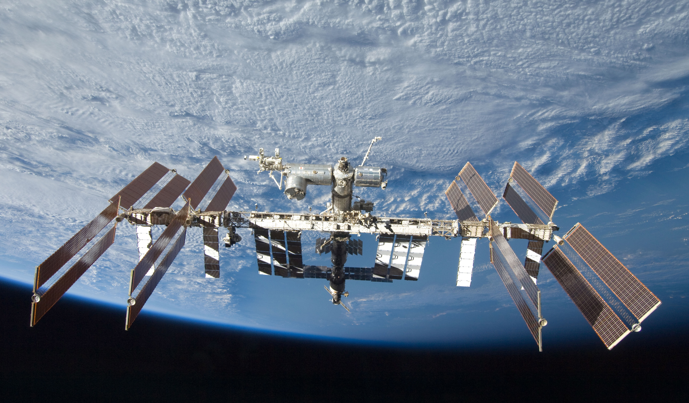
ISS: The Current Frontier

Slide 6
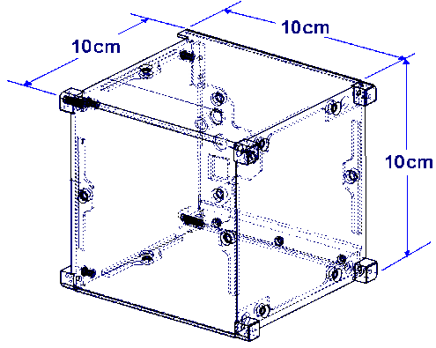
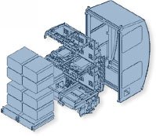
NanoRacks Frame 1/2Concept
EXPRESS Rack Locker holds Middeck Locker Replacements
EXPRESS Rack Locker holds NanoRacks Frames
Each NR Lab Frame holds up to 16 NR Lab Modules.
NanoRacks Frame provides power, USB data connectivity and forced air cooling to the Cube Lab Modules.
NR Frame breaks down to stow in a single CTB.
NanoRacks Modules can be stowed in any size CTB.
NanoRacks Modules can be returned in a Soyuz or Dragon.
NanoRacks, LLC assists Payload Integrators with design to minimize impact to the space transportation system and the ISS
Cube Lab Frame with 16 Cube Lab Modules
EXPRESS Rack
Locker

Slide 7
JEM Module with NanoRack Frames

Slide 8
Up Close Frame 1/2a
USB data 2.0
Power: 5V 0.3A per USB port
All commanding and data transfer through command prompt
Air cooled

Slide 9
The Cubes
Any orientation requirements for launch, return and on-orbit need to be identified early
Cold Stow is available but also needs to be requested early
Detail your ops plan for contingencies

Slide 10
Stuff to Remember while Building
Keep track of everything you use
Keep a log
Prototype a lot and early
Plan to have everything done early – delays will come up
Always feel free to ask for help
Pictures are worth a thousand words – include lots of drawings and pictures when sending us data

Slide 11
Backup Slides
Pretty Pictures

Slide 12
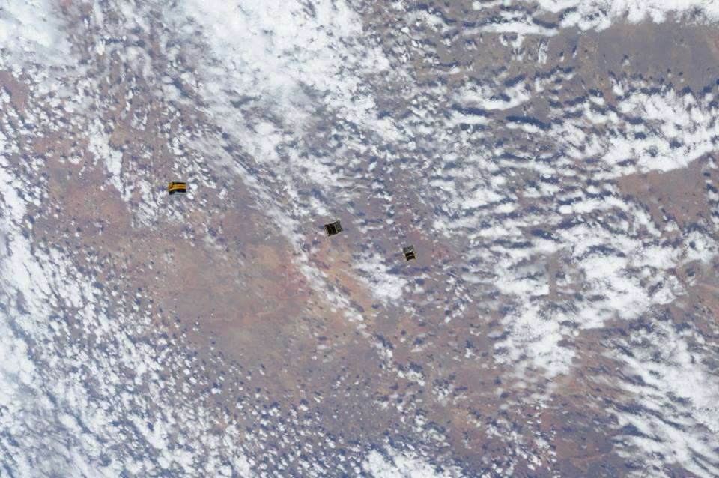
ArduSat Deployment

Slide 13
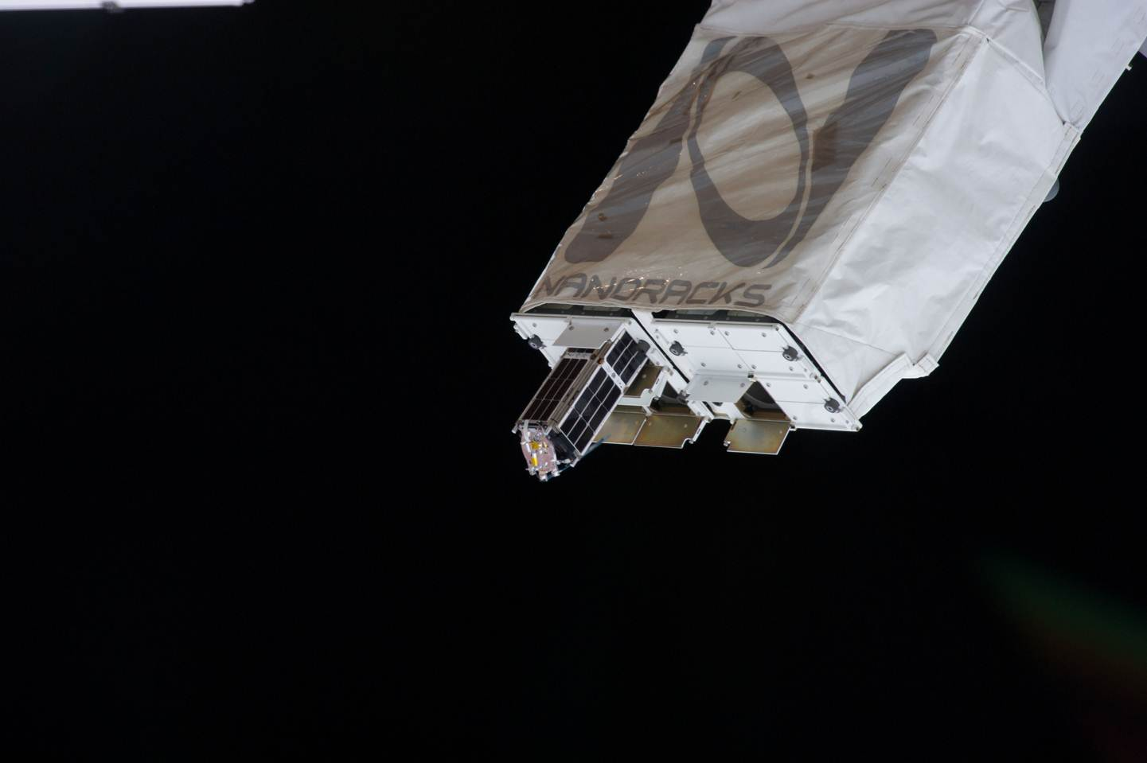

Slide 14
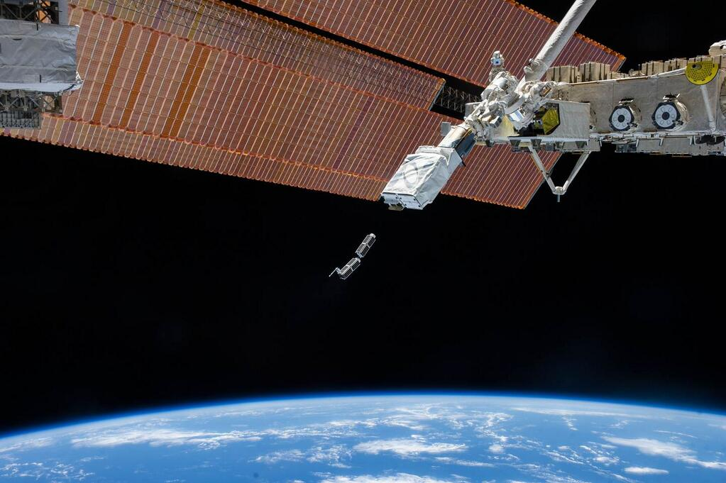

Slide 15
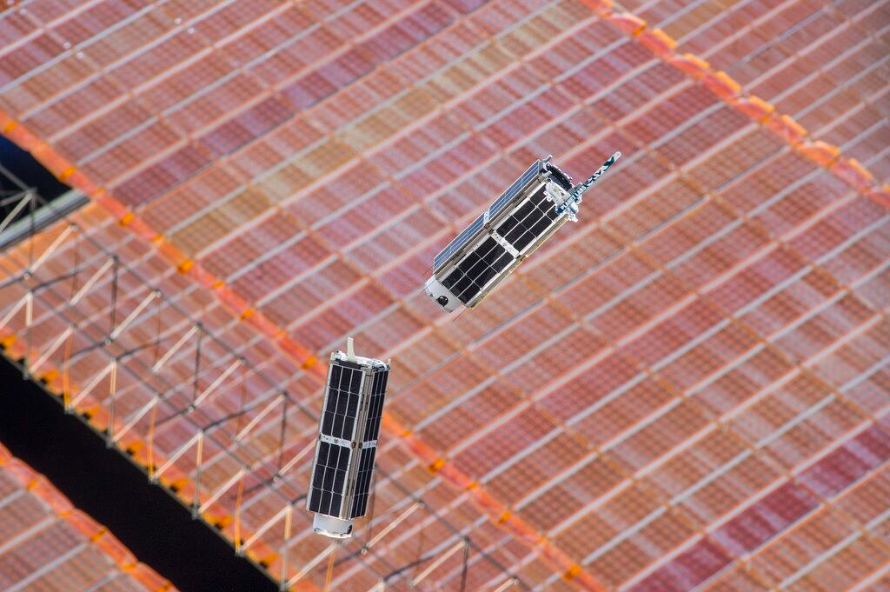

Slide 16
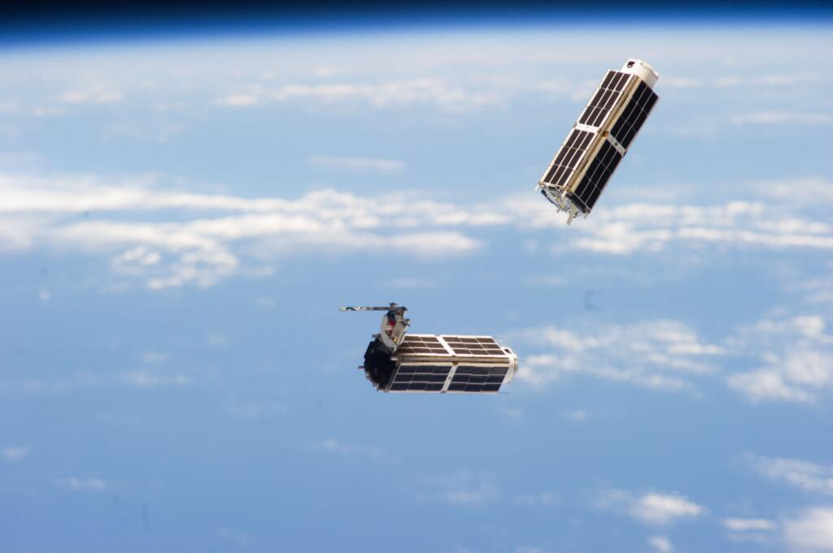

Slide 18
Deployment of Historical Cubesats

